Slide 1

Grocery Store
Management
Retail & Grocery Domain

Slide 2
About Team:
Team leader:
Name: Saurav kumar
Qualification: Bsc chemistry (hons)
Institution: Patliputra University
Core Interests: I am interested in Data science because I enjoy to solve real world business problem using Data
Career Objective: To secure a position as a Software Developer where I can utilize my programming skills, problem-solving abilities, and passion for technology to develop innovative software solutions.
Linked In: https://www.linkedin.com/in/saurav-kumar-55743140b/

Slide 3
Team Members:
Name : Venu Madhav Jidugu
Background: B.Tech
Why do you want to learn Data Science? I want to learn Data Science because I enjoy solving real-world problems using data.
Work Experience: I am a fresher and do not have any professional work experience yet.
LinkedIn: Link
GitHub: Link
Name : Bala Kishan
Background: Masters in Business Administration
WHY DS:- Because I like to work with Data
Work Experience: I am a fresher and do not have any professional work experience yet.
LinkedIn: Link
GitHub: Link

Slide 4
Agenda
PPT Flow & Structure
01
Project Objective
02
Database Schema
Goals and scope of the Grocery Store SQL analysis
7-table relational database: ER diagram & table relationships
03
Customer Insights
04
Product Performance
Unique customers, top buyers, purchase behavior analysis
Sales volume, revenue by product, category & supplier
05
Sales & Order Trends
06
Supplier & Employee
Monthly trends, weekday vs weekend order patterns
Top suppliers by revenue; employee performance metrics
07
Order Details Deep Dive
08
Conclusion & Q&A
Unit pricing, quantity patterns, item-level insights
Key findings, challenges, and open questions

Slide 5
Project Objective
🏗️
Design & Implement
🔍
Data Extraction
Build a relational database for a grocery store with 7 interrelated tables
Use SQL queries to retrieve and manipulate data across entities
📊
Business Insights
⚙️
SQL Mastery
Analyze top customers, best-selling products, and revenue trends
Practice joins, aggregations, subqueries, and date-based filtering

Slide 6
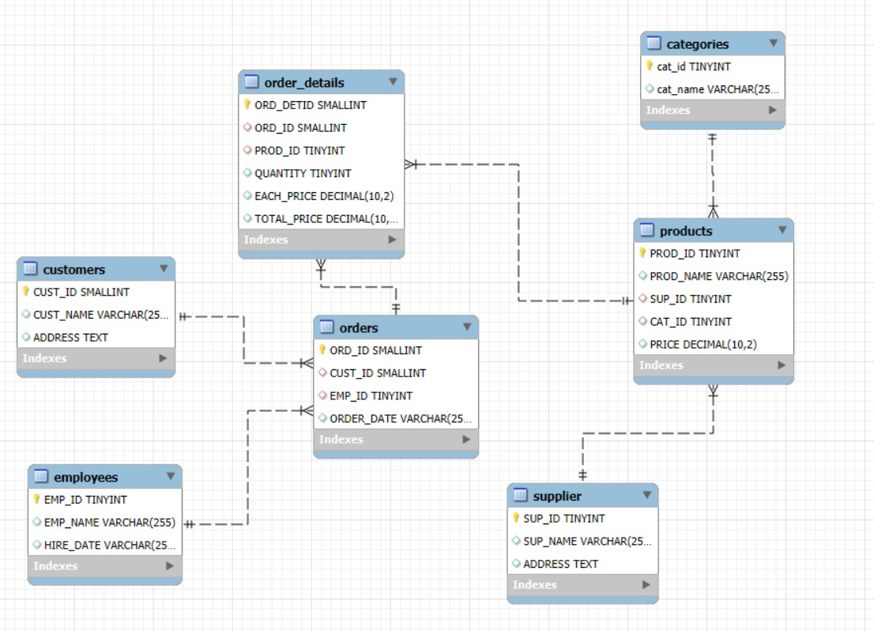
ER Diagram
Database Schema — 7 Interrelated Tables
Key Relationships
supplier → products (1:M)
categories → products (1:M)
products → order_details (1:M)
orders → order_details (1:M)
customers → orders (1:M)
employees → orders (1:M)

Slide 7


USE CASE 1.1
Customer Insights
❓ How many unique customers have placed orders?
Result :
SQL Query :
💡 Insight
156 unique customers have placed at least one order. This is a healthy customer base indicating good market reach. Focus on retaining these customers with loyalty programs to increase lifetime value.
⚙ How This Query Works :
COUNT(DISTINCT cust_id) counts only unique customer IDs — customers with multiple orders are counted once. FROM orders scans the entire orders table, making this a single-table, single-pass query.

Slide 8
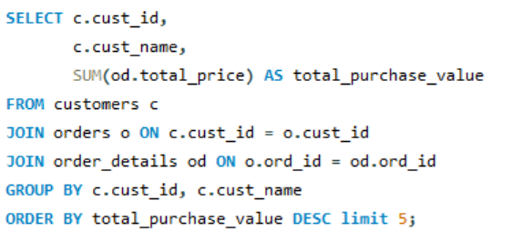
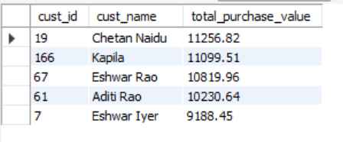
USE CASE 1.2
Customer Insights
❓ Who are the top 5 customers by total purchase amount?
SQL Query :
Result :
💡 Insight
Chetan Naidu leads with ₹11,257 in total spend. The top 5 customers together account for significant revenue. These VIP customers deserve priority service, exclusive offers and loyalty rewards to ensure retention.
⚙ How This Query Works :
Three-table JOIN links customers to orders to order_details. SUM(total_price) totals each customer spend. GROUP BY collapses rows per customer, and ORDER BY DESC LIMIT 5 picks the top spenders.

Slide 9
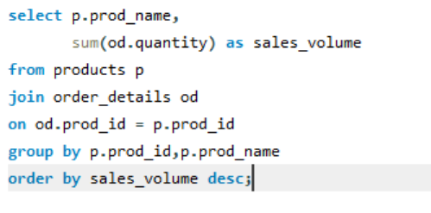
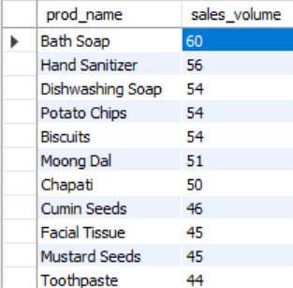
USE CASE 2.1
Product Performance
❓ Which products have the highest total sales volume (by quantity)?
SQL Query :
Result :
💡 Insight
⚙ How This Query Works :
JOIN connects products to order_details via prod_id. SUM(quantity) per product name ranks items by units sold. ORDER BY DESC with LIMIT 10 keeps output focused on best-sellers only.
Bath Soap dominates with 60 units sold — highest in the store. Personal Care items (Bath Soap, Hand Sanitizer, Dishwashing Soap) occupy the top 3 spots, indicating strong daily-use demand. Stock prioritization is critical for these SKUs.

Slide 10
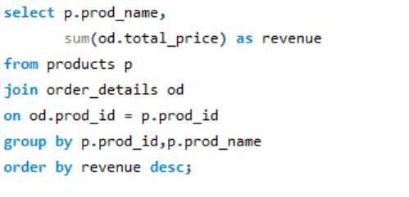
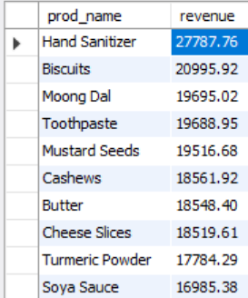
USE CASE 2.2
Product Performance
❓ What is the total revenue generated by each product?
SQL Query :
Result
💡 Insight
Hand Sanitizer generates the highest revenue at ₹27,788 — nearly 32% more than the second product (Biscuits). Despite Bath Soap having higher unit sales, Hand Sanitizer wins on revenue due to a higher price point. Pricing strategy matters greatly.
⚙ How This Query Works :
SUM(total_price) per product computes revenue — a pricier product can outrank a high-volume cheap one. This reveals where real revenue comes from, not just what sells in quantity.

Slide 11
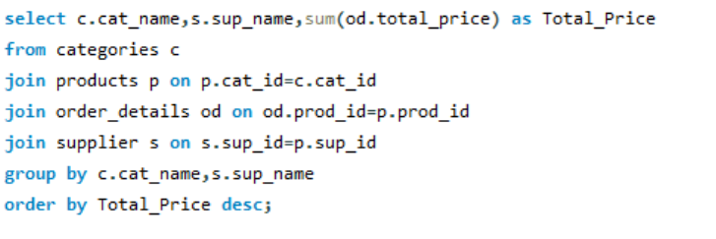
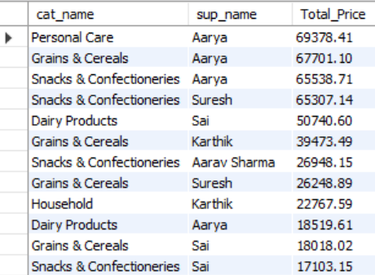
USE CASE 2.3
Product Performance
❓ How do product sales vary by category and supplier?
SQL Query :
Result
💡 Insight
⚙ How This Query Works :
Four-table JOIN: order_details to products to categories to supplier. GROUP BY two columns (category + supplier) reveals which supplier-category pairs drive the highest volume.
Supplier Aarya dominates across 3 of the top 5 category-supplier combos, contributing heavily to Personal Care, Grains & Snacks. This dependency is a supply chain risk — diversifying procurement is recommended.

Slide 12
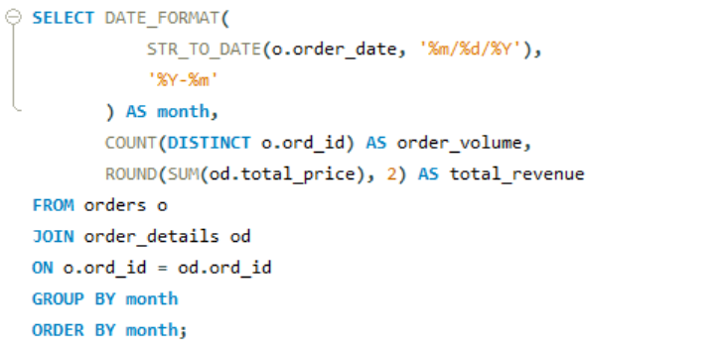
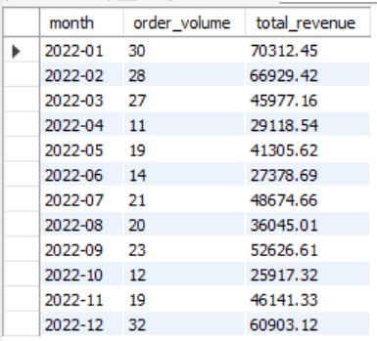
USE CASE 3.1
Sales & Order Trends
❓ What are the monthly trends in order volume and revenue?
SQL Query :
Result
💡 Insight
January 2022 is the peak month with 30 orders & ₹70,312 revenue. April is the lowest with only 11 orders. This clear seasonality suggests the store should ramp up inventory & promotions heading into Q1 each year.
⚙ How This Query Works :
STR_TO_DATE() converts the VARCHAR ord_date to a real date. DATE_FORMAT extracts YYYY-MM. COUNT and SUM then aggregate per month, exposing clear seasonal trends over time.

Slide 13
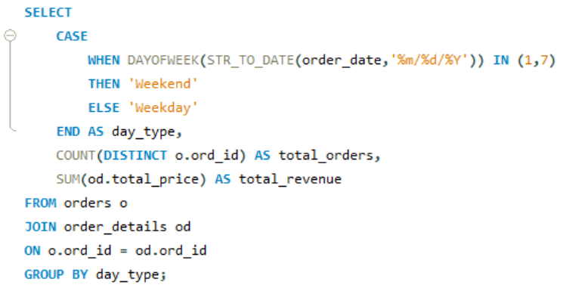

Sales & Order Trends
USE CASE 3.2
❓ How do order patterns vary across weekdays and weekends?
SQL Query :
Result :
💡 Insight
Weekdays see 2.5x more orders than weekends (183 vs 73) and 2.4x more revenue. This suggests the store serves a working-population base who shop during the week. Consider mid-week promotions to maximize this pattern.
⚙ How This Query Works :
CASE WHEN with DAYOFWEEK() classifies orders as Weekday or Weekend (days 1=Sun, 7=Sat). GROUP BY day_type then aggregates both order count and revenue for easy side-by-side comparison.

Slide 14
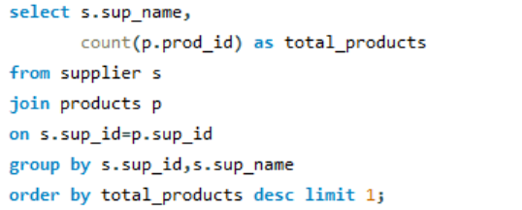

Supplier Contribution
USE CASE 4.1
❓ Which supplier provides the most products?
SQL Query :
Result :
💡 Insight
Supplier "Aarya" alone provides 18 products — the largest share of the catalog. This single-source dependency creates procurement risk. If Aarya faces supply disruption, a large portion of product range would be affected. Diversification is recommended.
⚙ How This Query Works :
JOIN supplier to products, then COUNT(prod_id) grouped by supplier name reveals catalog breadth per supplier. ORDER BY DESC immediately highlights who dominates the product range.

Slide 15
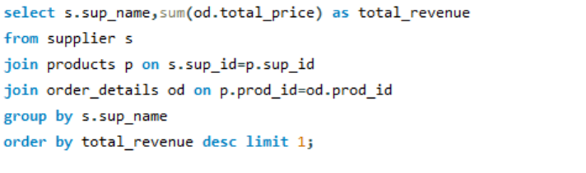

USE CASE 4.2
Supplier Contribution
❓ Which supplier contributes the most to total product sales?
SQL Query :
Result :
💡 Insight
⚙ How This Query Works :
Three-table JOIN (supplier to products to order_details) traces every sale back to its originating supplier. SUM(total_price) then ranks suppliers by total cumulative revenue contribution.
Aarya generates an impressive ₹2,21,138 in total revenue — the single highest-contributing supplier. This confirms Aarya as the most strategically vital partner. Contract renewals and volume discounts should be prioritized with this supplier.

Slide 16
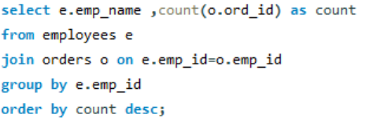

Employee Performance
USE CASE 5.1
❓ Which employees have handled the most orders?
SQL Query :
Result :
💡 Insight
⚙ How This Query Works :
JOIN employees to orders via emp_id, then COUNT(ord_id) grouped by employee name. ORDER BY DESC places the hardest-working employees at the top for easy HR performance review.
Diya Sharma leads with 38 orders processed, closely followed by Aditya Singh (37). The top performers handle ~25% more orders than the average. This data enables fair performance reviews and optimal workload distribution across the team.

Slide 17
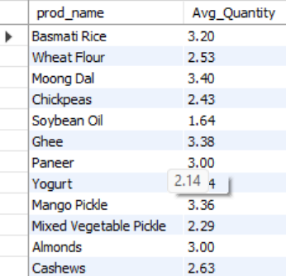
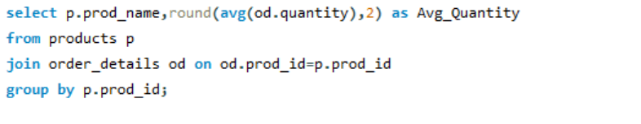
Order Details Deep Dive
USE CASE 6.1
❓ What is the average quantity ordered per product?
SQL Query :
Result
⚙ How This Query Works :
AVG(quantity) computes mean units per order line, grouped by product. ROUND to 2 decimals cleans output. High averages signal bulk-buy staples; low averages indicate single-unit purchases.
💡 Insight
Mustard Seeds (3.46) and Moong Dal (3.40) are ordered in the highest average quantities — these are pantry staples bought in bulk. Soybean Oil has the lowest avg (1.64). Bulk discount pricing on staples like Moong Dal could drive volume growth.

Slide 18
Conclusion
Key Findings & Business Insights
👥 Customers
📦 Products
A small group of top customers drives disproportionate revenue — VIP programs can amplify this.
Certain products dominate sales volume; maintaining their stock levels is mission-critical.
📅 Trends
🏭 Suppliers
Monthly analysis reveals seasonal peaks — inventory and staffing should align accordingly.
One or two suppliers supply the majority of SKUs and revenue — diversification reduces risk.
👔 Employees
🔢 Orders
Top performers handle significantly more orders — recognition & training programs are recommended.
Weekend vs weekday patterns suggest different customer segments with distinct buying behaviors.

Slide 19
Challenges & Experience
🔗 Table Relationships
Understanding how all 7 tables interconnect required careful study of the ER diagram and foreign key constraints.
🗓️ Date Parsing
Order dates stored as VARCHAR required STR_TO_DATE() conversion for any time-based analysis.
⚙️ Complex JOINs
Multi-table joins (3–4 tables) needed precise ON conditions to avoid duplicates and Cartesian products.
📊 Aggregation Accuracy
Ensuring SUM/AVG was computed at the right grain (per order vs per line item) was a recurring challenge.
🎯 Performance
Some queries on large datasets were slow; adding GROUP BY indexes improved execution times.

Slide 20
Q & A
Questions & Answers
Feel free to ask anything about the Grocery Store SQL Project

Slide 21
THANK YOU

